Slide 1

Presentation-Group 11 Project-T1 Clickbait spoiler
Vetsa tarun - 12041720
BSv Kiran - 12040440
GM imdadulla khan – 12040530
NBS Bharath KUMAR REDDY - 12040940

Slide 2
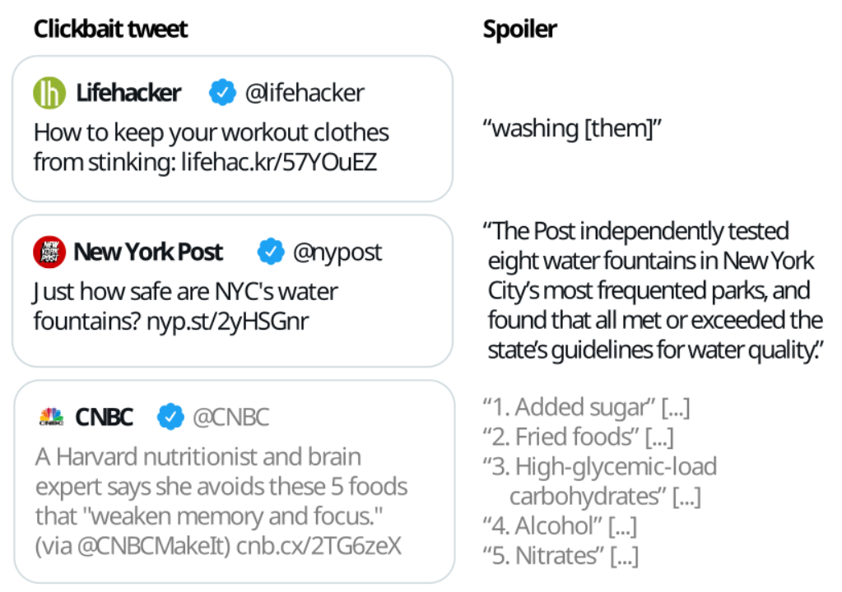
Clickbait spoiler
Clickbait refers to online content that uses sensational or misleading headlines to attract clicks and views. The goal of clickbait is to generate traffic to a website or web page, often without providing much informative content. Clickbait spoiling involves creating brief summaries or snippets of information that cater to the curiosity piqued by a clickbait post.

Slide 3
Task1- Finding Spoiler Type
Problem Statement :
Task 1 on Spoiler Type Classification: The input is the clickbait post and the linked document.
The task is to classify the spoiler type that the clickbait post warrants (either "phrase", "passage", "multi").
For each input, an output like
{"uuid": "<UUID>", "spoilerType": "<SPOILER-TYPE>"}
has to be generated where <SPOILER-TYPE>
is either phrase, passage, or multi.

Slide 4
Dataset
The data comes in JSON Lines format (.jsonl) where each line contains a clickbait post and the manually cleaned version of the linked document. For each entry in the training and validation dataset.
The following fields are available:
uuid: The uuid of the dataset entry.
postText: The text of the clickbait post which is to be spoiled.
targetParagraphs: Consists of the paragraphs of manually extracted main content linked to the webpage.

Slide 5
Dataset
targetTitle: The title of the linked web page to classify the spoiler type (task 1) and to generate the spoiler (task 2).
targetUrl: The URL of the linked web page.
humanSpoiler: The human generated spoiler (abstractive) for the clickbait post from the linked web page. This field is only available in the training and validation dataset (not during test).
spoiler: The human extracted spoiler for the clickbait post from the linked web page. This field is only available in the training and validation dataset (not during test).

Slide 6
Dataset
spoilerPositions: The position of the human extracted spoiler for the clickbait post from the linked web page. This field is only available in the training and validation dataset (not during test).
tags: The spoiler type (might be "phrase", "passage", or "multi") that is to be classified in task 1 (spoiler type classification). For task 1, this field is only available in the training and validation dataset (not during test). For task 2, this field is always available and can be used.
Some fields contain additional metainformation about the entry but are unused: postId, postPlatform, targetDescription, targetKeywords, targetMedia.

Slide 7
Dataset - example
{ "uuid": "0af11f6b-c889-4520-9372-66ba25cb7657", "postText": ["Wes Welker Wanted Dinner With Tom Brady, But Patriots QB Had Better Idea"], "targetParagraphs": [ "It’ll be just like old times this weekend for Tom Brady and Wes Welker.", "Welker revealed Friday morning on a Miami radio station that he contacted Brady because he’ll be in town for Sunday’s game between the New England Patriots and Miami Dolphins at Gillette Stadium. It seemed like a perfect opportunity for the two to catch up.", "But Brady’s definition of \"catching up\" involves far more than just a meal. In fact, it involves some literal \"catching\" as the Patriots quarterback looks to stay sharp during his four-game Deflategate suspension.", "\"I hit him up to do dinner Saturday night. He’s like, ‘I’m going to be flying in from Ann Arbor later (after the Michigan-Colorado football game), but how about that morning we go throw?’ \" Welker said on WQAM, per The Boston Globe. \"And I’m just sitting there, I’m like, ‘I was just thinking about dinner, but yeah, sure. I’ll get over there early and we can throw a little bit.’ \"", "Welker was one of Brady’s favorite targets for six seasons from 2007 to 2012. It’s understandable him and Brady want to meet with both being in the same area. But Brady typically is all business during football season. Welker probably should have known what he was getting into when reaching out to his buddy.", "\"That’s the only thing we really have planned,\" Welker said of his upcoming workout with Brady. \"It’s just funny. I’m sitting there trying to have dinner. ‘Hey, get your ass up here and let’s go throw.’ I’m like, ‘Aw jeez, man.’ He’s going to have me running like 2-minute drills in his backyard or something.\"", "Maybe Brady will put a good word in for Welker down in Foxboro if the former Patriots wide receiver impresses him enough." ], "targetTitle": "Wes Welker Wanted Dinner With Tom Brady, But Patriots QB Had A Better Idea", "targetUrl": "http://nesn.com/2016/09/wes-welker-wanted-dinner-with-tom-brady-but-patriots-qb-had-better-idea/", "spoiler": ["how about that morning we go throw?"], "spoilerPositions": [[[3, 151], [3, 186]]], "tags": ["passage"] }

Slide 8
Overview of the Task-1
Clickbait Spoiler Detection using SVM Classifier
The code uses an SVM classifier to detect clickbait spoiler type for a given data.
We have two sets of data one for training and one for validation.
The text data is pre-processed and converted into numerical vectors using the TF-IDF vectorizer.
Convert the spoiler types into numeric labels.
The SVM classifier is trained on the pre-processed training data and numeric labels.

Slide 9
Overview of the Task-1
Prediction and Evaluation
The trained SVM classifier is used to predict the clickbait spoiler for the validation data.
The predicted values are converted back to the original labels and saved in JSONL format.
The actual labels are extracted from the validation data.
The accuracy of the model on the validation data is computed and printed.
The SVM classifier with TF-IDF vectorizer is an effective method to detect clickbait spoiler in text data.

Slide 10
Task2 – Finding Spoiler
Problem Statement :
Task 2 on Spoiler Generation: The input is the clickbait post and the
linked document (and, optional, the spoiler type if your approach uses this field).
The task is to generate the spoiler for the clickbait post.
For each input, an output like {"uuid": "<UUID>", "spoiler": "<SPOILER>"}
has to be generated where <SPOILER> is the spoiler for the clickbait post.

Slide 11
Overview of the Task-2
The data present in train.jsonl and validation.jsonl have been read and stored in dic_train, dic_valid dictionaries and converted into dataframes.
The code uses the Transformers library, which provides a simple interface for training and evaluating Question Answering models(DistilBERT) using different architectures.
The model is trained using a trained posts. The DistilBertTokenizer and DistilBertForQuestionAnswering are used for tokenizing the text and generating the answer respectively.
The use of a QuestionAnsweringModel helps to answer questions related to the text data in a more efficient manner.

Slide 12
Overview of the Task-2
After training the model with train.jsonl data, it evaluates the model which is used to make predictions on the validation data.
The predictions are based on the probabilities of all possible answers for each question in the validation data.
The predicted answers are extracted from the probabilities and stored in a list.
The final output is stored in a DataFrame format containing the UUIDs and predicted spoiler texts.
The output can be used for further analysis or evaluation of the model's performance.
Reference Link: https://towardsdatascience.com/question-answering-with-pretrained-transformers-using-pytorch-c3e7a44b4012

Slide 13


